Slide 1
Week 11 Presentation
By J. Jedediah Smith

Slide 2
What was tried?
Troubleshoot some errors with Rob.
Re-try downloading reference databases for classifiers.
Analyze the Long-Read BuqSeq results.

Slide 3
How did it go?
Rob got my conda running out of the right place by fixing bash.rc file.
Rob helped me fix a Kraken2 error by updating it to latest version and deleting a duplicate file that was left over from that.
Kraken2 reference database is now downloaded and ready to go!
Centrifuge library download still causes errors?
rsync error 255. Problem with SSH connection or rsync syntax?
BugSeq data has been analyzed! Comparisons on next slides.

Slide 4
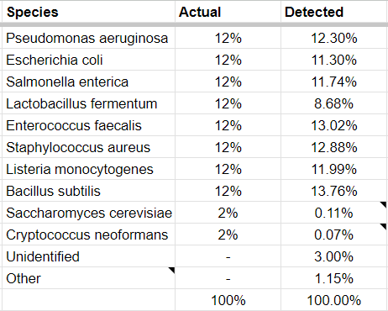
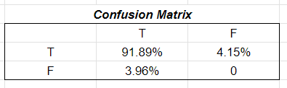

BugSeq Analysis
Accurate as predicted.
Identified all species in initial sample.
Most reads classified on a species level.
Abundance estimates were pretty good.
Better for 12% bacteria
Poor for 2% fungi

Slide 5
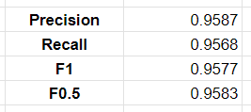
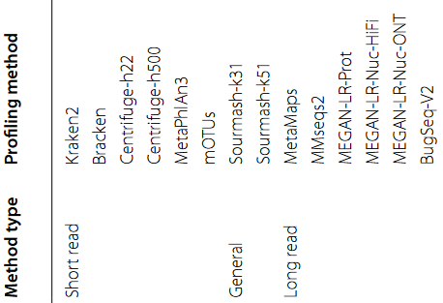
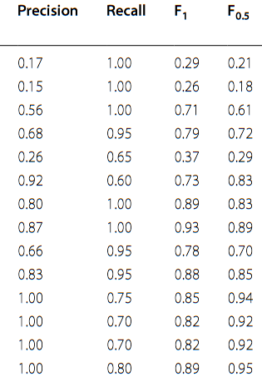
BugSeq Comparison
High performance in all categories.
F0.5 score matches with the one calculated for BugSeq.
Appears to be better than all short read techniques.
Paper that generated this data was benchmarking long-read tools. Bias?
https://bmcbioinformatics.biomedcentral.com/articles/10.1186/s12859-022-05103-0

Slide 6
Where to go next?
Run the classification with Kraken2.
Get the CCMetagen library to downloaded.
Should be able to get on the node in the right place now.
Space concerns addressed?
nohup wget (or SBASH script)
Keep trying to debug Centrifuge.
Long Read / BugSeq portion appears complete!

